Slide 1
Karun Dhingra, MS, Data Science (IU)
Clustering and Classification of IEEE audio signal for information Extraction
Presenter

Slide 2

Overview
I have designed this report for using a IEEE audio signal dataset and some noise to extend it to a large mixed signal dataset on different SNR to implement clustering algorithms like K Means, Gaussian Mixture Model for finding the similarity trend, and Multi-Layer Perceptron classifier to train these signals on the classification criteria for SNR as labels.

Slide 3
Resources:
MATLAB R2017b
Python 2.7 (Numpy, pandas, scikit, matplotlib,pyAudioAnalysis)
Microsoft Office 2010
JetBrains PyCharms
Anaconda2 – 5.1.0

Slide 4
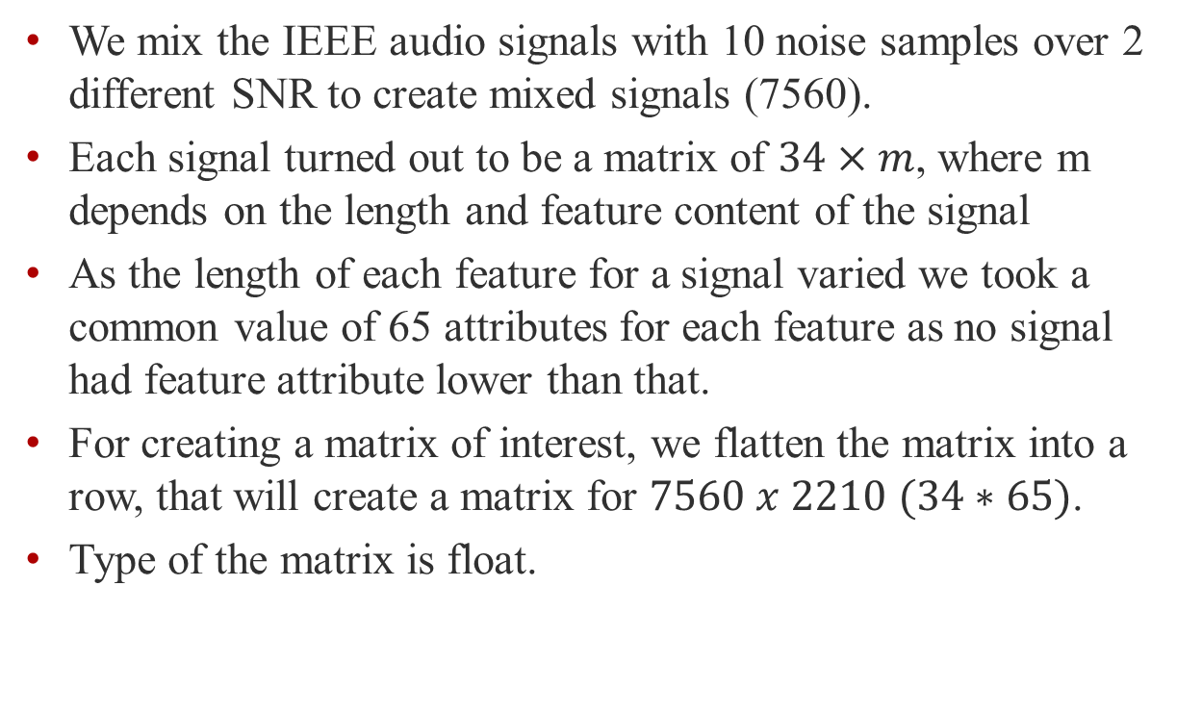
Data Preparation:
We mix the IEEE audio signals with 10 noise samples over 2 different SNR to create mixed signals (7560).
Each signal turned out to be a matrix of $34×m$, where m depends on the length and feature content of the signal
As the length of each feature for a signal varied we took a common value of 65 attributes for each feature as no signal had feature attribute lower than that.
For creating a matrix of interest, we flatten the matrix into a row, that will create a matrix for $7560 x 2210 (34∗65)$.
Type of the matrix is float.
-ve
+ve

Slide 5
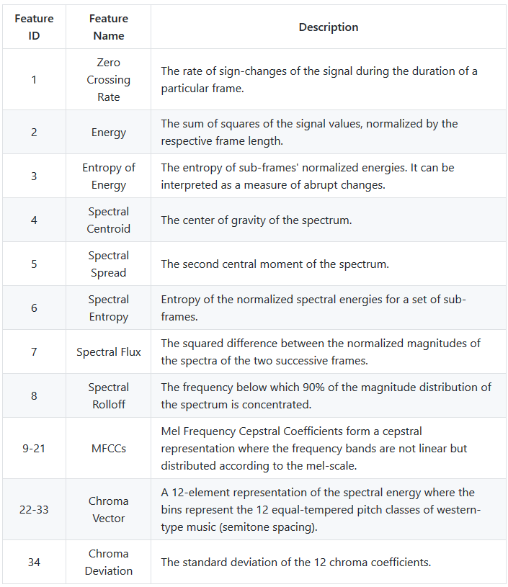
Data Configuration Library:
pyAudioAnalysis helps extract audio features(34) and representations
signal represented as matrices for processing .

Slide 6
Unsupervised approach:
Audio signal clustering forms the basis for speech recognition, audio synthesis, audio retrieval, etc.
Their clustering is undertaken based on this consideration and solving the problems in high-dimensional data clustering, in this regard, is highly beneficial.
We can see using the clusters what features overlap or act as a total different entity.
Various forms of clustering algorithms are available with specific behavior.
K means, GMM, Agglomerative Hierarchical Clustering etc.

Slide 7
K Means
k-means clustering is a method of vector quantization, originally from signal processing, that is popular for cluster analysis in data mining. k-means clustering aims to partition n observations into k clusters in which each observation belongs to the cluster with the nearest.
We used scikit learn K means with Lloyd algorithm as a method of approach.
The cluster formation shows anomaly as whatever the number of cluster you set the output is coming as 1 cluster. Let’s see why this is happening.

Slide 8
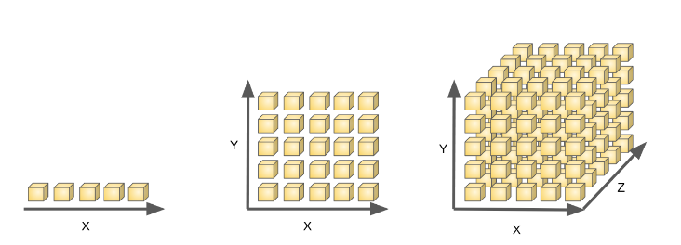
Curse of Dimensionality
In very high-dimensional spaces, Euclidean distances tend to become inflated (this is an instance of the so-called “curse of dimensionality”).
Running a dimensionality reduction algorithm such as PCA(Feature Extraction) or by Feature Selection(variance Threshold, correlation) prior to k-means clustering can alleviate this problem and speed up the computations.

Slide 9
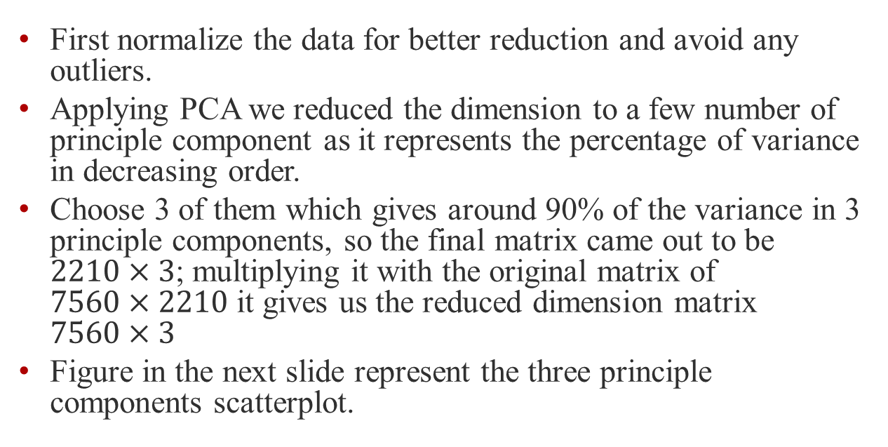
Principle Component Analysis
First normalize the data for better reduction and avoid any outliers.
Applying PCA we reduced the dimension to a few number of principle component as it represents the percentage of variance in decreasing order.
Choose 3 of them which gives around 90% of the variance in 3 principle components, so the final matrix came out to be $2210×3$; multiplying it with the original matrix of $7560×2210$ it gives us the reduced dimension matrix $7560×3$
Figure in the next slide represent the three principle components scatterplot.

Slide 10
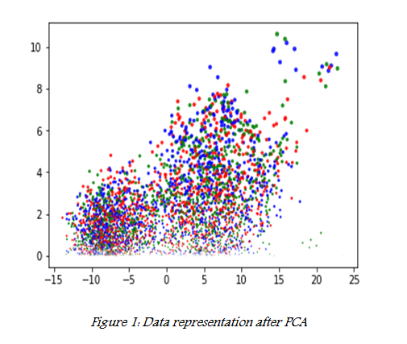
Principle Component Analysis

Slide 11
K Means
k-means clustering works good on the reduced dataset using Lloyd algorithm with cosine and correlation distance function.
We try to choose different values of clustering from 2 to 11. I choose k-mean ++ that are in algorithms term is the version of Lloyd Algorithm. MSE is taken as the criteria for choosing the right number of clusters.
Table on the next page shows comparison for two different distance measure for different cluster value.

Slide 12
Distance /Cluster Table Matrix
Distance/Clusters | 2 | 3 | 4 | 5 | 6 | 7
Cosine | 0.150 | .1286 | .1148 | .1286 | .1291 | .115
Correlation | .1283 | .1126 | .1031 | .0827 | .0907 | .0953

Slide 13
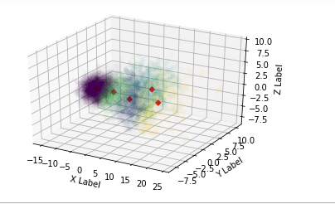
K Means (5 – Clusters)

Slide 14
Gaussian Mixture Model
GMM clustering is more flexible because you can view it as a fuzzy or soft clustering method. The algorithm that fits a GMM to the data can be sensitive to initial conditions.
Seems certainly more likely that the point that follows the trend should match closer to the Gaussian than the point that doesn’t.
Figure on the next slides shows resemblance of the clustering of GMM with that of K Means.

Slide 15
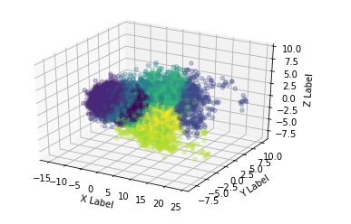
GMM(5 – Clusters)

Slide 16
Comparison of Algorithm
K-Means doesn’t take into account the covariance of our data.
Only two cluster kind of overlap and has some common points among them the rest of the clustering is similar for both GMM and K means, which clarifies there exist a similar set of features as we have assumed so.
We ran both the algorithms for no of clusters to be 9,10,11 taking into account the total set of features we divided but there was enough overlap to smartly choose a lower number.

Slide 17
Classification
Audio signal classification (ASC) consists of extracting relevant features from a sound, and of using these features to identify into which of a set of classes the sound is most likely to fit.
SNR classification is a criteria to fit a set of audio signal features to a positive SNR Class or negative.
The idea of model selection out of a defined/relevant hypothesis space is a tricky task.

Slide 18
Classification (Data Prep)
We have a subset of the dataset we used for the sake of clustering. This subset comprises of 7560 audio signal with 3870 positive SNR(5 DB) and 3780 negative SNR (-5 DB).
Flatten array converted to matrix of the dimension of 7560 x 2210 is created using the same process as we did in clustering.
Due to high dimensional nature of the data set and 34 features involved in each signal, it is a wise choice of using a multi layer perceptron.

Slide 19
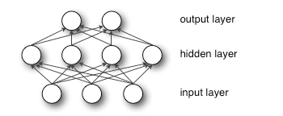

Multilayer Perceptron(MLP)
An MLP is a network of neurons called perceptrons. The basic concept of a single perceptron was introduced by Rosenblatt in 1958. The perceptron computes a single output from multiple real-valued inputs by forming a linear combination according to its input weights and then possibly putting the output through some nonlinear activation function

Slide 20
Model
We see in our dataset creation section we have a set of classified labels on the basis of SNR as the label (1 if SNR is positive and 0 if it’s negative)
Here ReLU has been used as the activation function over sigmoid or hyperbolic tangent due to sparsity and a reduced likelihood of vanishing gradient. .
We can try with different variation of hidden layers. With a variation of data split of 70 – 30 we have created a confusion matrix. The dimension of the dataset is 7560 * 2210.
We tried this model for the actual dataset and a reduced one.

Slide 21
Confusion Matrix I
 | precision | recall | Fi-score | support
0 | 1.00 | 1.00 | 1.00 | 982
1 | 1.00 | 1.00 | 1.00 | 908
Avg/total | 1.00 | 1.00 | 1.00 | 1890
Definitely something is not right here but the models behavior is like because of the high dimensionality of the data. We observed the same kind of issue with the K Means algorithm as well so we have to work on reducing Features.

Slide 22
Reduced Data
We saw the results were not right for the complete dataset as the variance didn’t make any difference for such large set of features(curse of dimensionality).
We used the reduced data using PCA, a new matrix been used after PCA with 3 principle components.
Applying MLP to this reduced feature set shows promising results.
The prediction table is on the next slide which shows a decent prediction result on the test and training data.

Slide 23
Confusion Matrix II
 | precision | recall | Fi-score | support
0 | 0.97 | 0.96 | 0.97 | 931
1 | 0.96 | 0.97 | 0.97 | 959
Avg/total | 0.97 | 0.97 | 0.97 | 1890
Precision and recall (sensitivity) are kind of the same percentage means the prediction for the total population was right to a value.
The F-1 Score is the harmonic mean of the two so its around 97% as both precision and recall are in the same range for positive and negative SNR.

Slide 24
Conclusion
We can see that the accuracy is good with the MLPClassifier which is around 97% on the reduced data set. It’s obvious that the high dimensionality of the data doesn’t let the classifier work fine.
Coming to the clustering We try to setup the whole clustering around the original audio signal data converted to a matrix to the dimension of the extraction, but the high dimensionality of the matrix caused problem for the implementation of these algorithms as well, so we moved to the choice of taking a dimensionality reduction approach using PCA.
It came out to be obvious as there are prominent features that take up the cluster area, it is hard to tell which features are more prominent than the others, but we can always go ahead and check using some f-test to see the impact of adding a feature.
The same reduced dimension data is used to train a MLP Classifier which gave us a good accuracy for classification of the SNR on the positive and the negative values. Further work can include using various levels of Hidden Layers to see the effect on the training of the network.

Slide 25
References
[1]: EURASIP Journal on Audio, Speech, and Music processing 20172017:26 https://doi.org/10.1186/s13636-017-0123-3© The Author(s). 2017 Wenfa Li, Gongming Wang and Ke Li
[2]: http://scikit-learn.org/stable/modules/clustering.html
[3]: Complex Ratio Masking for Monaural Speech Separation - Donald S. Williamson, Student Member, IEEE, Yuxuan Wang, and DeLiang Wang, Fellow, IEEE[4]
[4]:https://www.kdnuggets.com/2016/10/beginners-guide-neural-networks-python-scikit-learn.html/2
[5]: Wang Y., Narayanan A. and Wang D.L. (2014): On training targets for supervised speech separation.

Slide 26
Thank you

